Slide 1
solar based mini refrigerator for medicine prevention in rural areas.

Slide 2
FEATURES
This will helps to keep cold medicine powered by solar
This refrigerator operates on pal-tier
This pal-tier will works on battery which will helps to maintain temperature low
This will maintain temperature at least 5 to 20 degrees

Slide 3
Block Diagram &
It’s Explanation

Slide 4
TRASNMITTER BLOCK DIGRAM:-
TEMPRETURE SENSOR
CONTROLLER
PALTIER
DRIVER
PALTIER
SOLAR PANNEL
BMS
BATTERY

Slide 5

PALTIER MODULE
High reliability.
0- 20 DEGREE temperature
It works on Paltier effect
Paltier makes one side heat
and one side cold

Slide 6
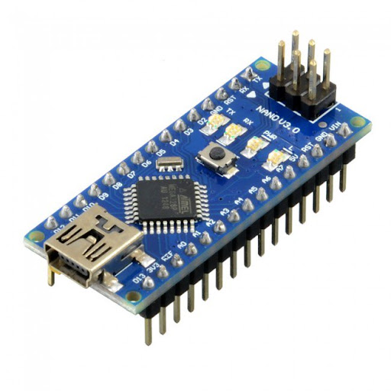
ARDUINO NANO:
It has 8 bit microcontroller.
It operates on 5V power supply.
It operates on 16MHZ crystal frequency.
It has on chip 64 KB flash memory.
On chip timer is available.
It has 16 input/output pins.

Slide 7
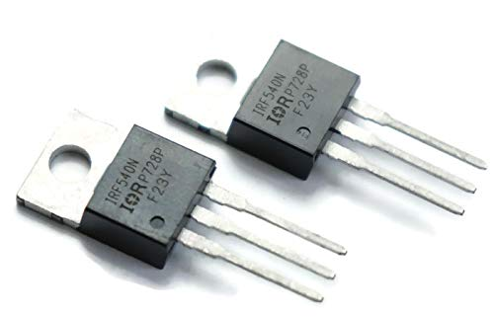
Paltier Driver
We are going to used IRF 540N Mosfet.
It operates on 5V & 12V power supply.
It operates on 5V digital logic.
It is used to drive Paltier.
It will deliver up to 2 AMP current

Slide 8
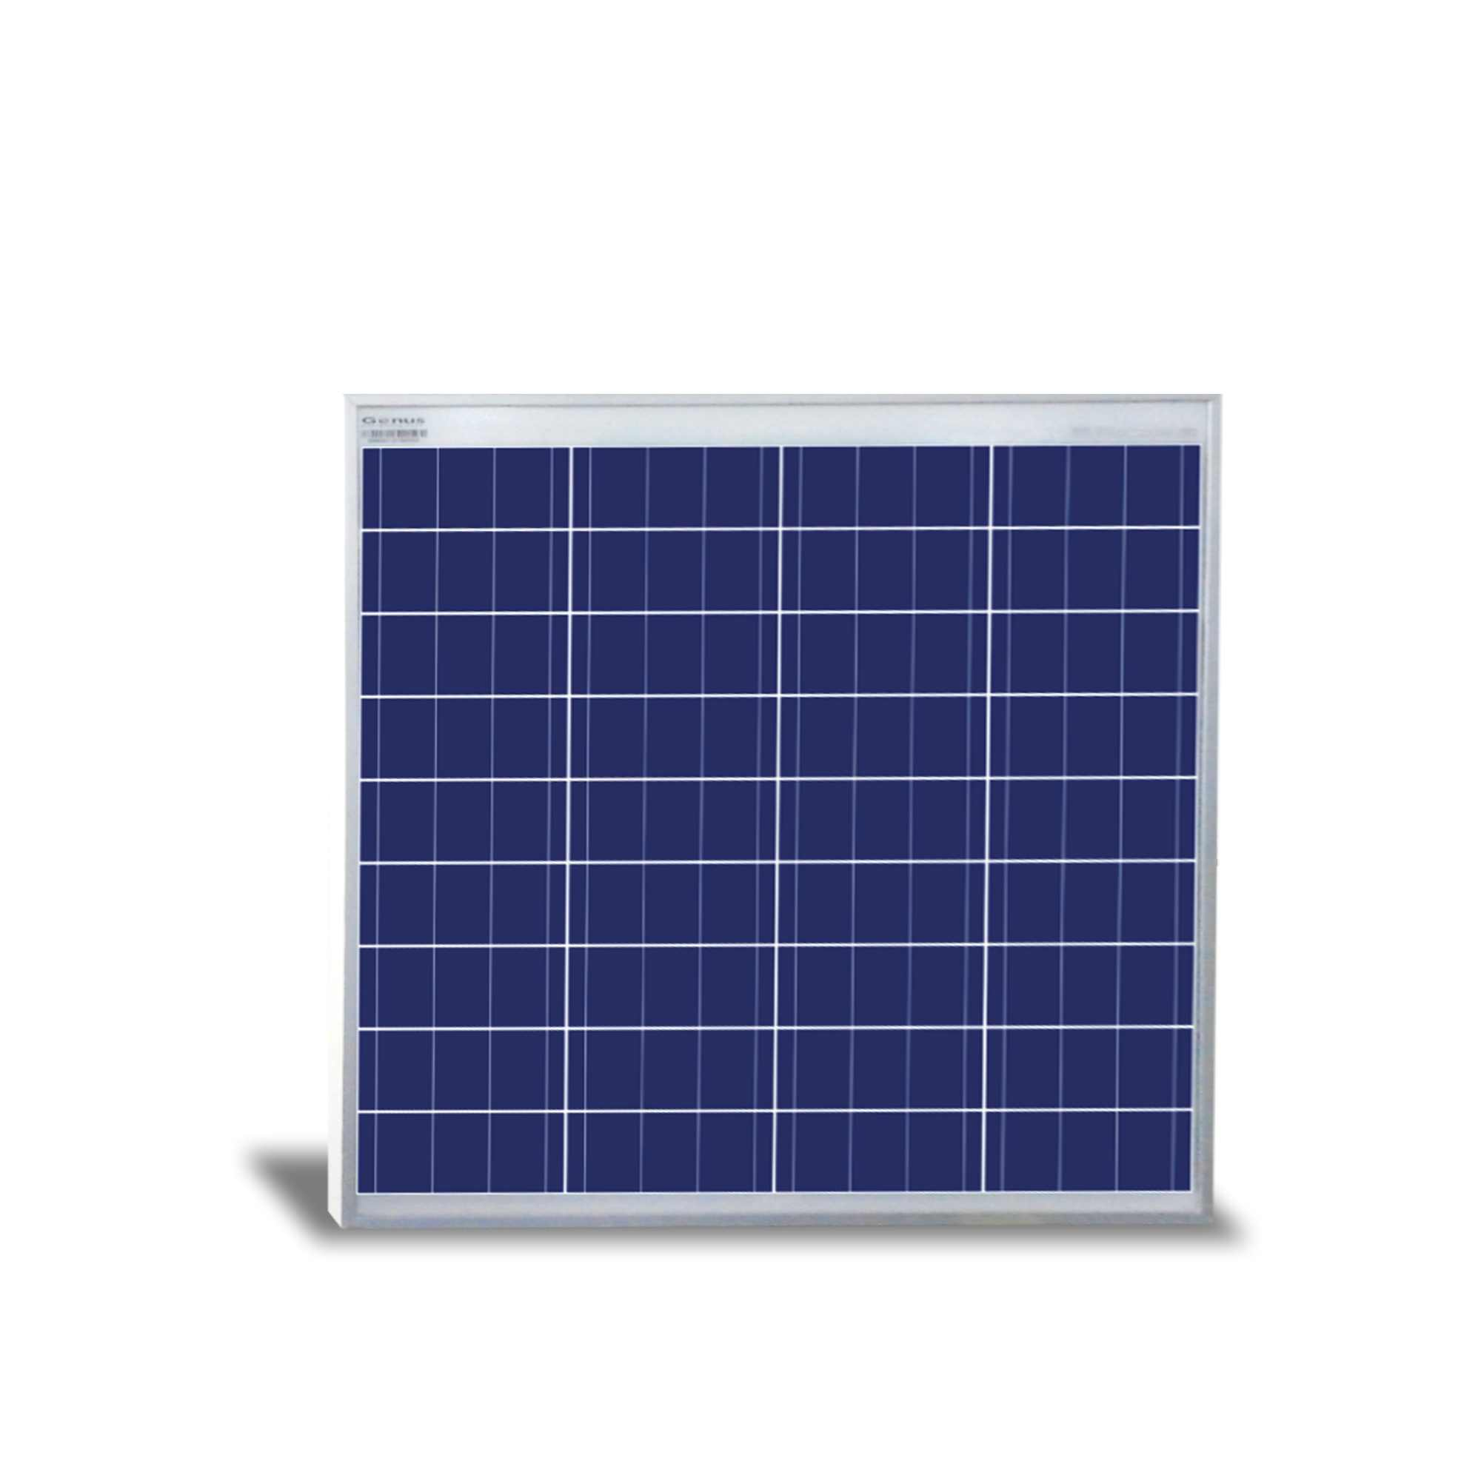
Solar Plate
12v 12 watt solar pannel
It is used to charge the battery.

Slide 9

Battery
12 V battery is used
It is used to power to robot
Backup for robot is 3 hrs

Slide 10
N0 | COMPONENTS | QTY | COST | TOTAL
1 | ARDUINO NANO MODULE | 1 | 600 | 600
2 | Paltier Module | 1 | 500 | 500
3 | Irf540 | 2 | 200 | 400
4 | 12V BATTERY | 1 | 800 | 800
5 | Dc fan | 1 | 200 | 200
6 | Temperature sensor | 1 | 300 | 300
7 | WIRES | 10 | 100 | 100
 | TOTAL |  |  | 2900RS

Slide 11
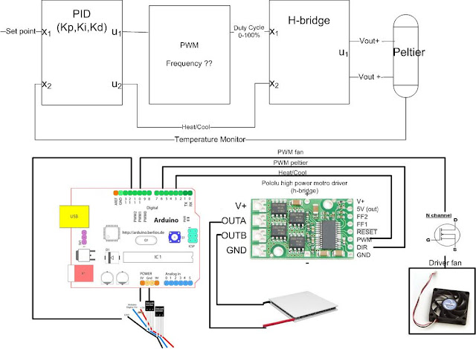
CIRCUIT DIAGRAM :

Slide 12
Advantages
We can carry this refrigenerator anywhere
This will charge anywhere with the help of solar
This can be used for any purpose to keep the cold

Slide 13
Thank you

